Slide 1
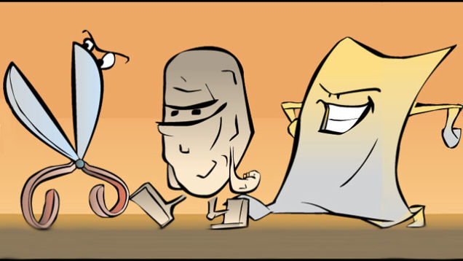
Rock Paper Scissors AI Game
Made by Camden Levy and John Castilloux

Slide 2



What our game is about
Computer vs. the player with the goal to win with the most points
User
AI

Slide 3
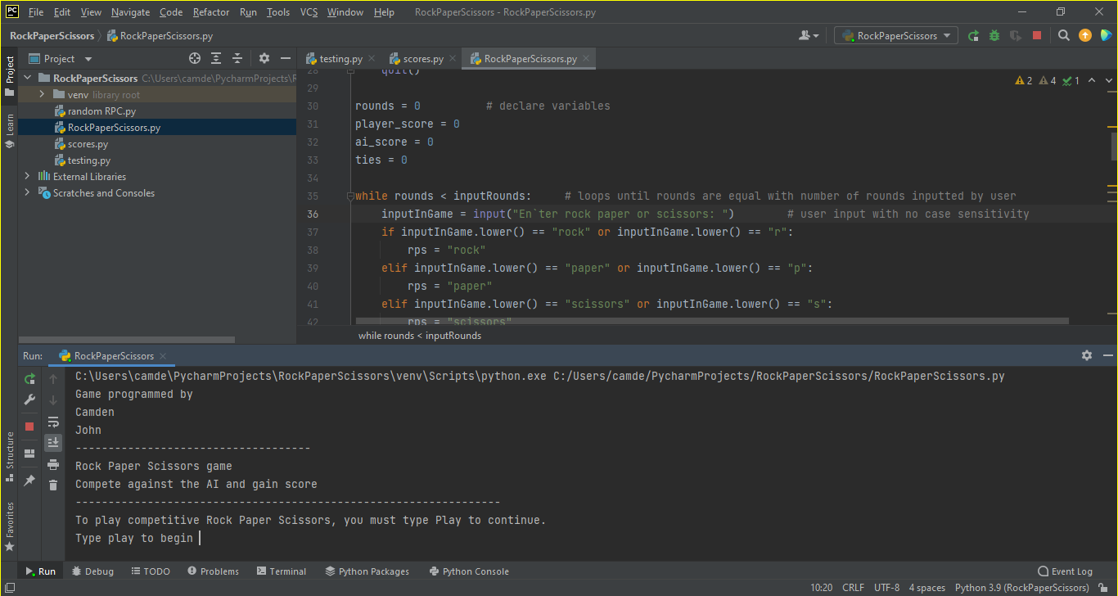
Running Our Game

Slide 4

How It Works (Important Sections)
Importing Random Function
User Input
Variables
While Loop for # of Rounds
Parsing Rock/Paper/Scissors
Random Generator As a Function for AI
Game Logic
Score Function
This Photo by Unknown Author is licensed under CC BY-NC-ND

Slide 5

Importing Random Function
Need random for the random number generator to work properly

Slide 6
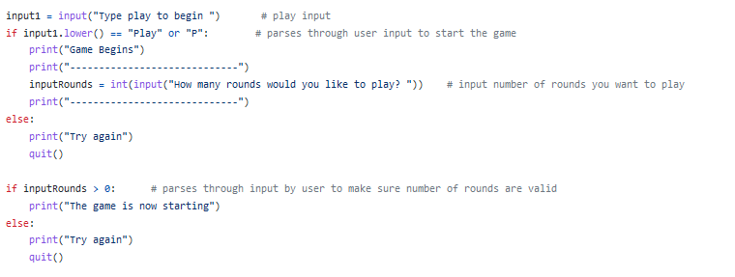
User Input
The User enters “play” to start the game, along with the # of rounds they want to compete in against the AI
Parsing
Parsing

Slide 7

Variables
These variables have been declared to be used as “counters”,
adding +1 if a certain criteria has been met for that variable.

Slide 8
While Loop For # of Rounds
The While Loop is based upon the rounds variable.
Rounds adds +1 every single loop until it is equal to the number stated in inputRounds during the user input stage
What is contained within our while loop?
- Rock/Paper/Scissors user input
- Game Logic
- Counters

Slide 9
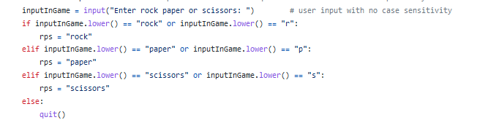
Parsing Rock/Paper/Scissors
The user is required to enter either R/P/S or Rock/Paper/Scissors
- Used .lower() to allow any variation of capital and lowercase characters
- Within the While loop (asks user for input every round)
Parsing

Slide 10
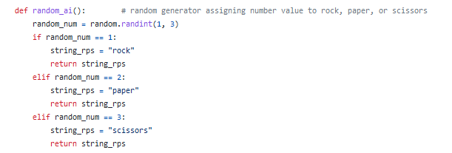
Random Generator As a Function for AI
Created our own callable function that spits out Rock/Paper/Scissors for the AI to use during the logic section.
- Picks a random number 1-3 (within loop, different each round)
- Gives a value of 1 to Rock, 2 to Paper, and 3 to Scissors
Converts random result to work with logic section

Slide 11
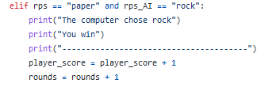
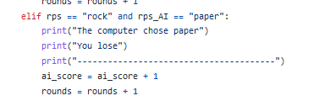
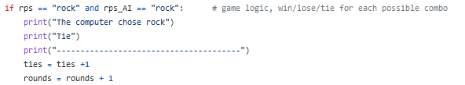
Game Logic
Rock, Paper, Scissors has 9 possible outcomes when playing
- 3 winning cases, 3 losing cases, 3 tie cases
- Counters are used here (adds + 1 during every loop iteration)
Adds to counters: player_score (winning) , rounds
Adds to counters: ai_score (losing) , rounds
Adds to counters: ties, rounds

Slide 12
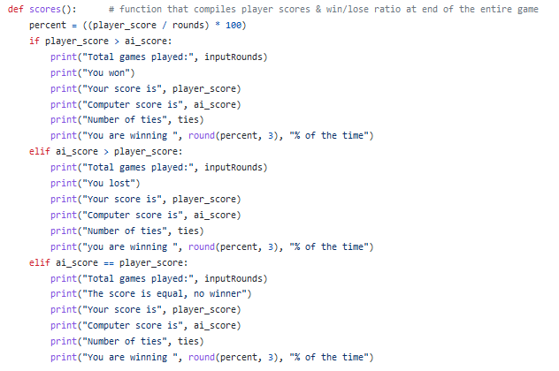
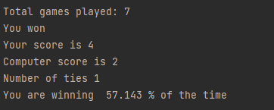
Score Function
Our custom score function tells the player:
- Total games played
- Their score
- Computer score
- Ties
- Win to lose ratio (rounded)

Slide 13
Final Comments
Made by Camden Levy and John Castilloux
Source code:
https://github.com/JohnAndCamdenPythonProject1
Play our game here and tell us what you think
Any Questions About our Program?

